Slide 1


CHEMSAFE TECHNOLOGY
SAKTHIVEL Balakumar

Slide 2



CONTENTS
Objective
Product Description
Early Detection
Security
Eco-Friendly
Process
Future Enhancement
Challenges

Slide 3


PROBLEM??
OBJECTIVE
SOLUTION!!!
PROBLEM??

Slide 4
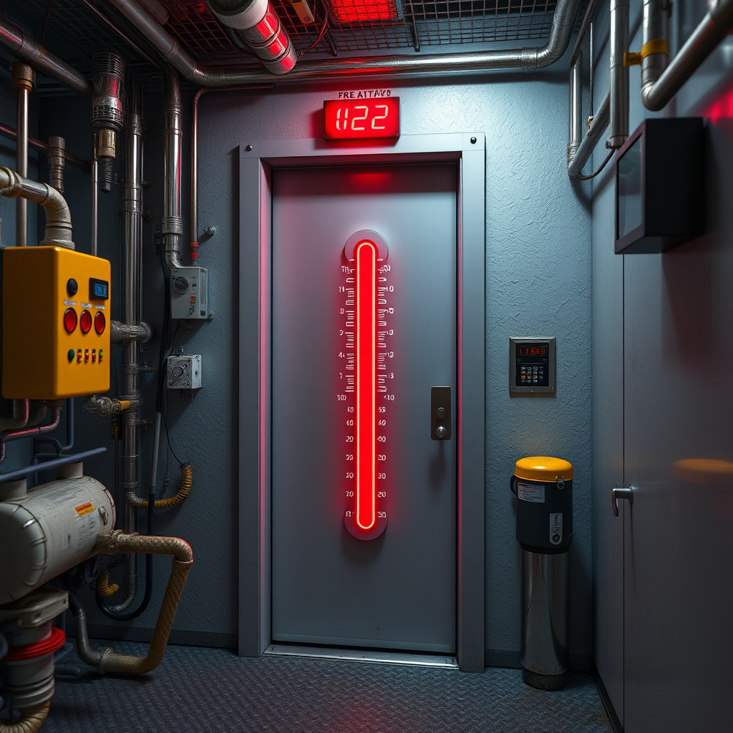
PRODUCT DESCRIPTION
Early Detection
Security
Eco-Friendly

Slide 5
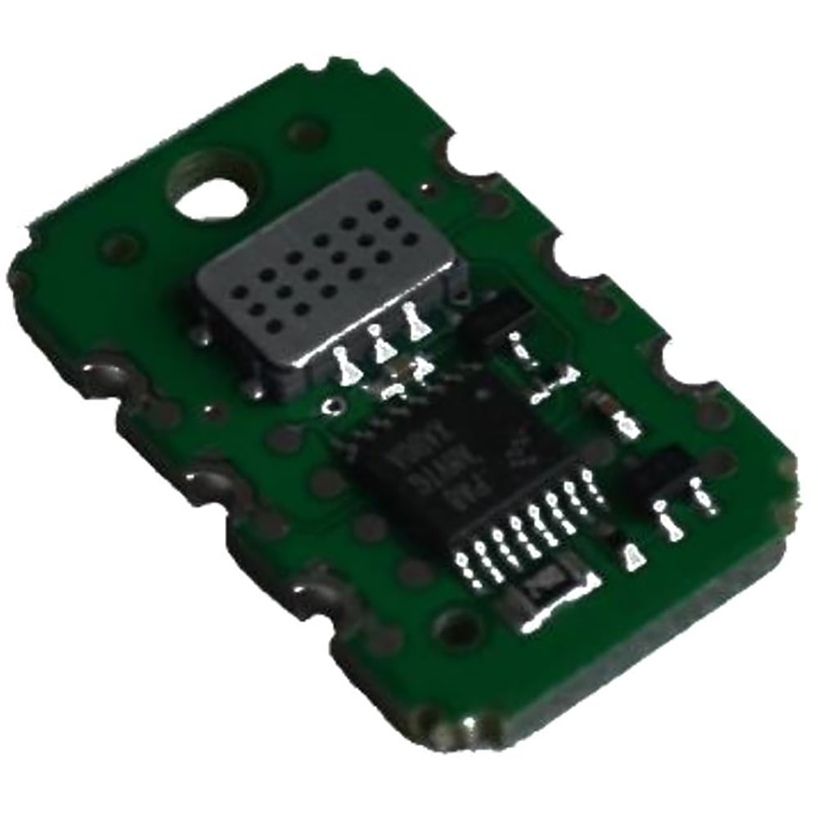
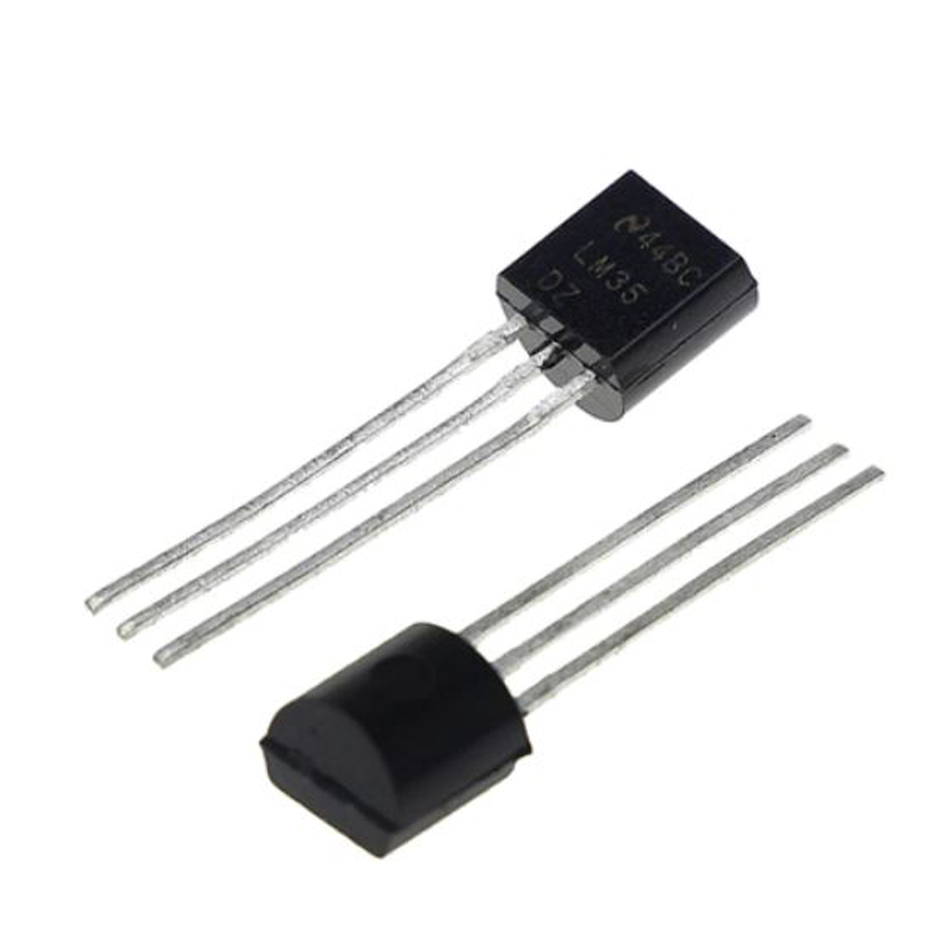
EARLY DETECTION
CO2 : MiCS-VZ-98-TE
LM35 temperature sensor

Slide 6
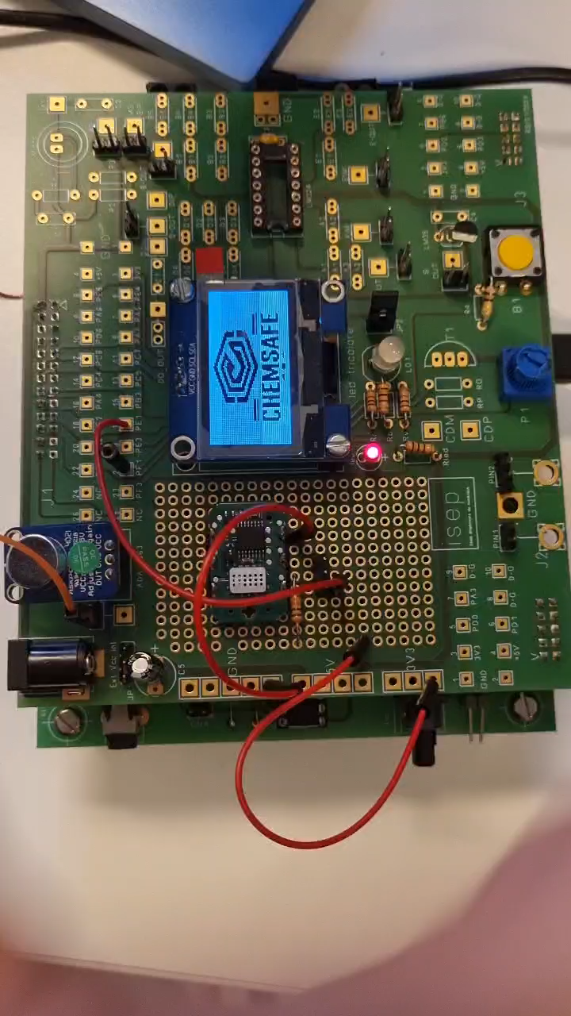
SECURITY
ADA-1063 Amplified Microphone Module
Bluetooth
Alarm
OLED

Slide 7

ECO-FRIENDLY
LED​ | OLED​ | BLUETOOTH​ | CURRENT (mA)​ | POWER CONSUMPTION​ | CARBON EQUIVALENT​
O​ | O​ | O​ | 119.9​ | 0.61​ | 0.161​
O​ | X​ | O​ | 104.0​ | 0.53​ | 0.139​
X​ | O​ | O​ | 102.5​ | 0.52​ | 0.137​
O​ | O​ | X​ | 108.1​ | 0.55​ | 0.145​
O​ | X​ | X​ | 106.5​ | 0.54​ | 0.142​
X​ | O​ | X​ | 105.8​ | 0.54​ | 0.142​
X​ | X​ | O​ | 100.8​ | 0.52​ | 0.137​
X​ | X​ | X​ | 95.0​ | 0.49​ | 0.129​
X - OFF​
O - ON

Slide 8
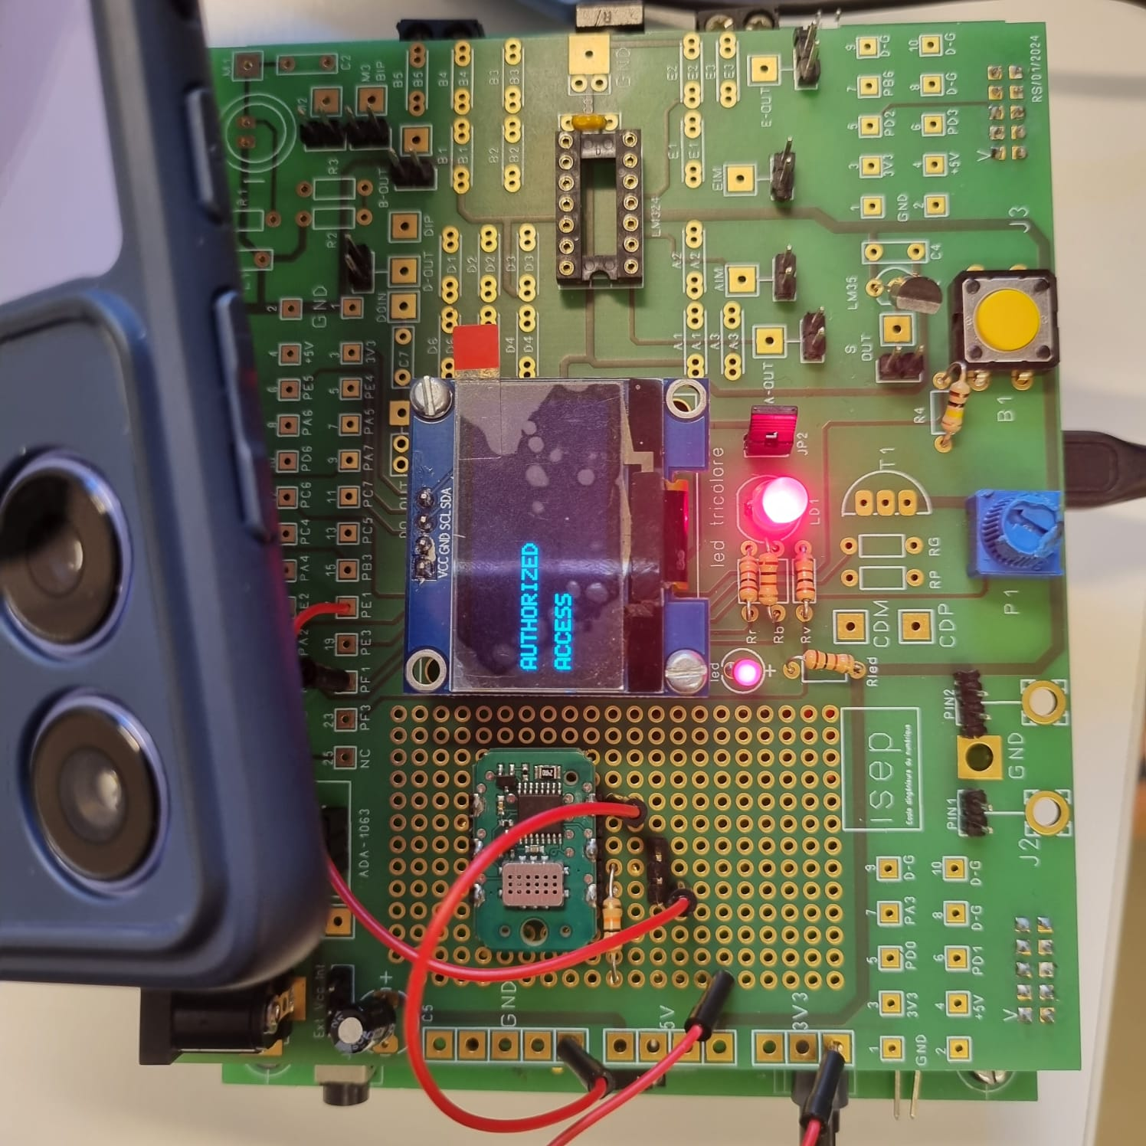
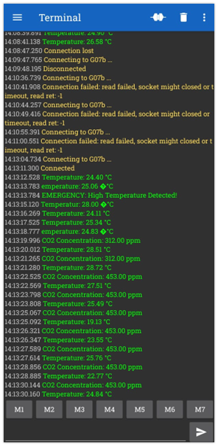
PROCESS

Slide 9

FUTURE ENHANCEMENT
Multi-Gas Detection
Cloud Connectivity
Carbon Footprint Monitoring
Solar-Powered Devices

Slide 10

CHALLENGES
SENSOR
BAND-PASS FILTER
CO2 SENSOR OUTPUT

Slide 11
THANK YOU

